Slide 2
A Focused
In a Busy World
Ephesians 5:15-17

Slide 3
Many couples are suffering from a TIME-STARVED marriage… “We’ve grown apart. We don’t have anything in common”… Translated: a couple is not spending enough time alone together
How much time are YOU giving YOUR marriage?

Slide 4
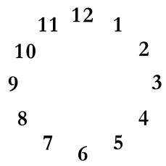
WHAT IS
SNATCHING
YOUR TIME ?
Electronics
Covet (Colossians 3:5; Ecclesiastes 2:10,11,17,18; 4:4-8 1 Timothy 6:10; Hebrews 13:4,5)…
Self-gratification…
Misplaced Priorities (Matthew 6:33; Ecclesiastes 12:13)

Slide 5
The First Casualty of Busyness is Spirituality
1 Corinthians 15:58; Galatians 6:9
The responsibility is clear…
To a husband (Ephesians 5:25-28)
To a wife (1 Peter 3:1-5)

Slide 6
What Do We Do To Have a Focused Marriage?
What is the solution?
“We need to ‘balance’ things better”

Slide 7
What Do We Do To Have a Focused Marriage?
Many believe Balance is doing as many things, having as many things, planning as many things, etc. without any of it falling over or failing…
BALANCE is a term we use to describe a priority we have not made…

Slide 8
What Do We Do To Have a Focused Marriage?
7 Time
Opportunities
Meals…
Travel…
Service to others together and to “one another” (Romans 16:3-5)
Recreation…

Slide 9
What Do We Do To Have a Focused Marriage?
7 Time
Opportunities
Rest -- Give at least two compliments a day (Ephesians 4:29; 1 Thessalonians 5:18); Focus on your mate for at least 10 minutes a day…
Pray together about and for each other daily…… Pursue God first…
Remove the distractions…

